Slide 1

2023 REPORT
BRIGHT COFFEE SHOP ANALYSIS
Data-Driven Insights for Strategic Growth
BY: VHONANI MPHOSHOMALE
Data Analytics Specialist
Transforming sales data into actionable intelligence.

Slide 2

BUSINESS OVERVIEW & KPIS
R698,812
149,116
214,470
TOTAL REVENUE
TOTAL TRANSACTIONS
QUANTITY SOLD
Prime NYC Locations
Analysis Period
Lower Manhattan, Hell’s Kitchen, and Astoria.
Comprehensive 6-month review from January to June 2023.

Slide 3

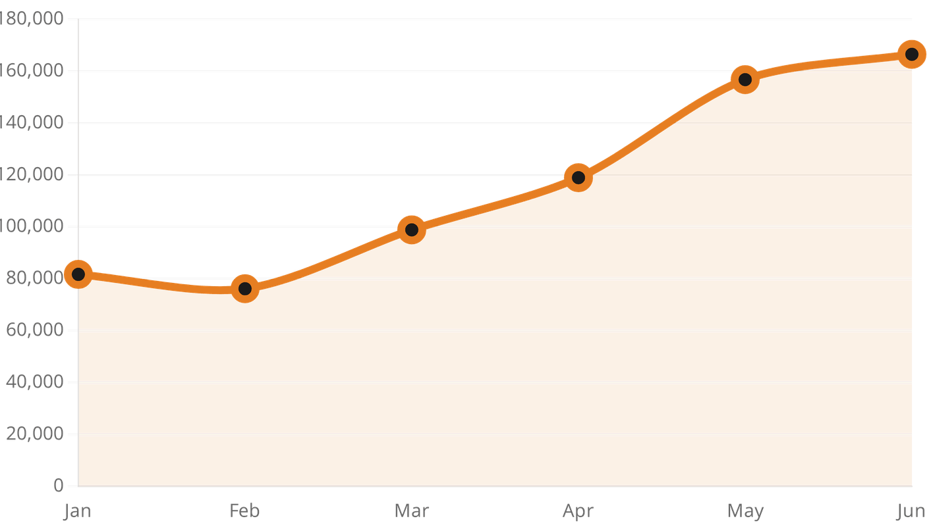
JUNE EMERGES AS PEAK PERFORMANCE MONTH
100%+ Revenue Growth
Revenue doubled from R81.6k in January to R166.4k in June, showing strong momentum.
Balanced Store Success
Performance is remarkably balanced across all locations, with Hell's Kitchen leading slightly.
Steady Upward Trend
Consistent month-over-month growth following a minor February dip.

Slide 4

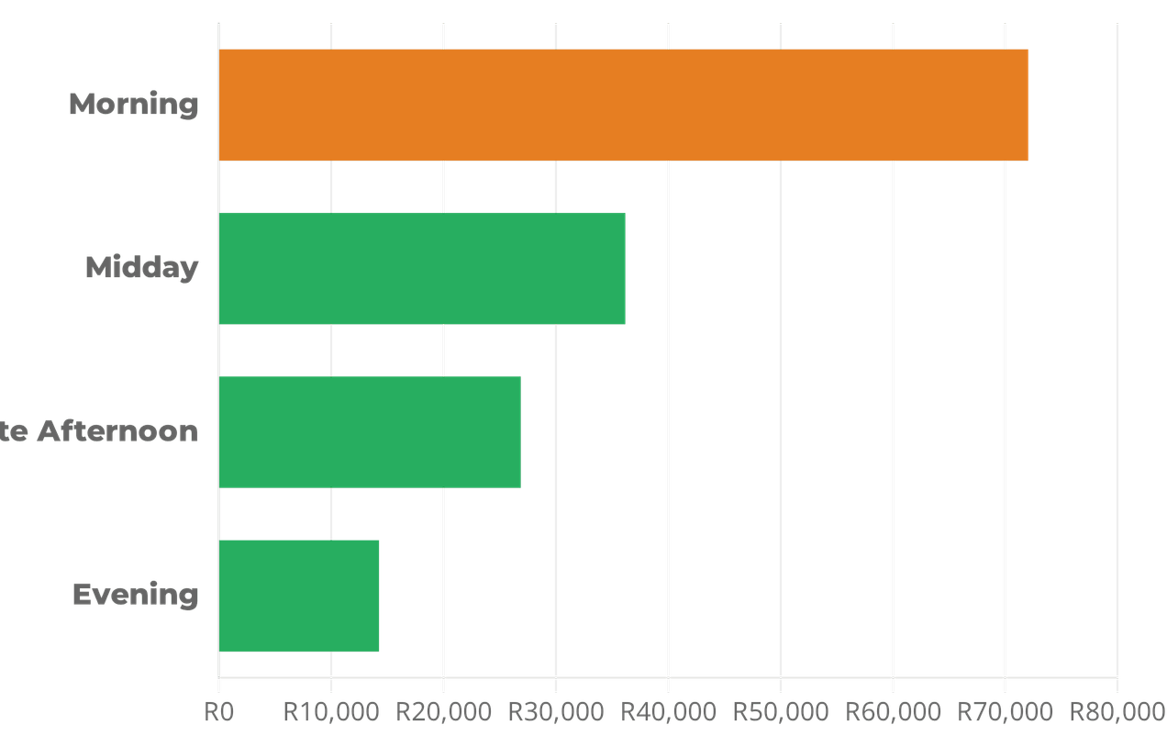
MORNING RUSH DRIVES NEARLY 50% OF DAILY REVENUE
STRATEGIC FOCUS
MORNING DOMINANCE
The 07:00 - 11:00 window generates R71,985, making it the critical revenue engine for the business.
OPERATIONAL PRIORITY
Staffing and inventory must be optimized for the 7 AM - 10 AM peak to maximize throughput and customer satisfaction.
* Revenue distribution by time bucket across all locations.
EVENING OPPORTUNITY
Sales drop to R14,193 in the evening, representing a significant untapped market for late-day promotions.

Slide 5

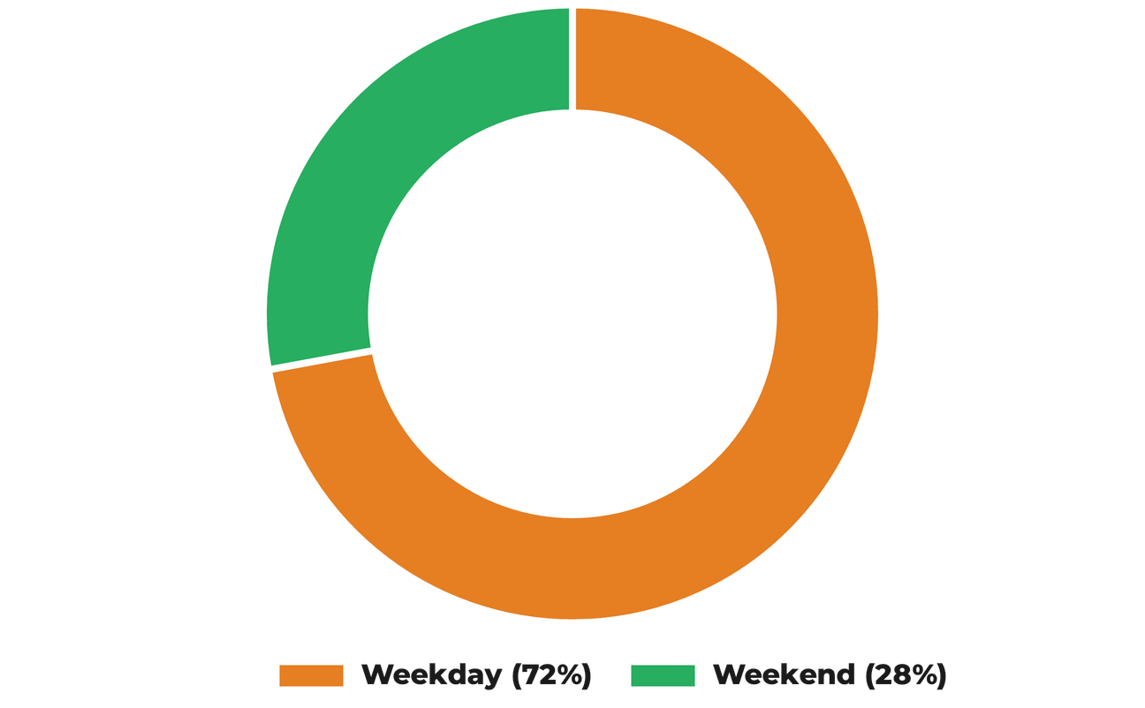
WEEKDAY TRAFFIC OUTPACES WEEKENDS BY 2.5X
STRATEGIC INSIGHTS
R107,510 (72%)
WEEKDAY REVENUE
Heavy reliance on the "commuter" and "office worker" demographic across all locations.
R41,606 (28%)
WEEKEND REVENUE
Opportunity to bridge the gap with "Weekend Family Bundles" or "Sunday Brunch Specials".

Slide 6

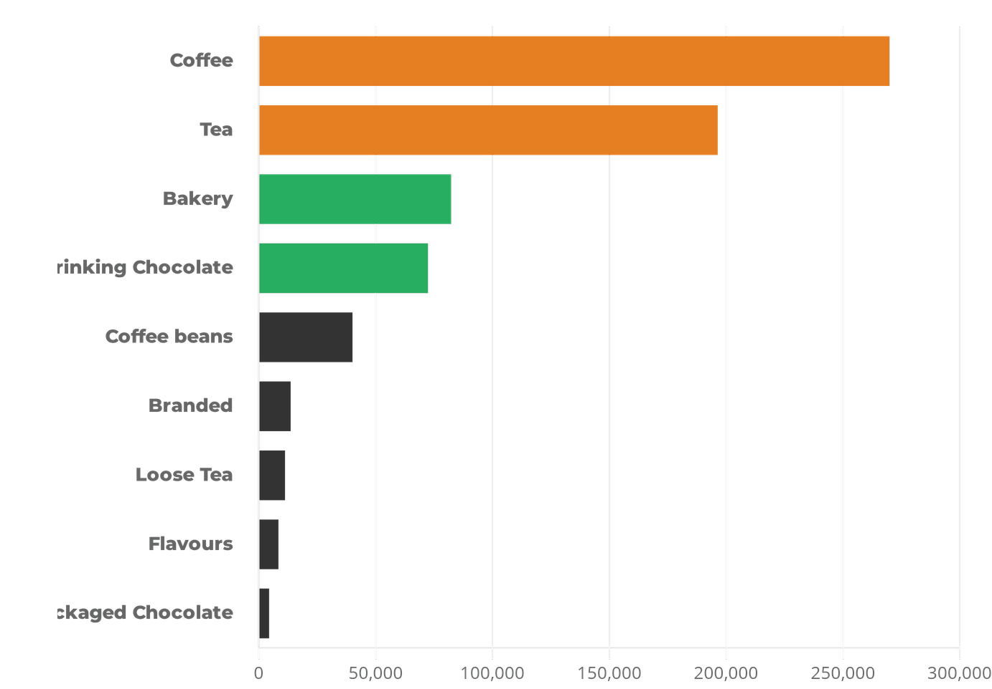
COFFEE AND TEA ACCOUNT FOR 67% OF TOTAL SALES
CORE PERFORMANCE
Undisputed Leaders
Coffee (R269k) and Tea (R196k) drive the vast majority of business revenue.
Bakery Attachment
Bakery items (R82k) show strong potential as high-margin complementary sales.
Menu Optimization
Branded goods and packaged items contribute <3%, suggesting room for menu simplification.

Slide 7

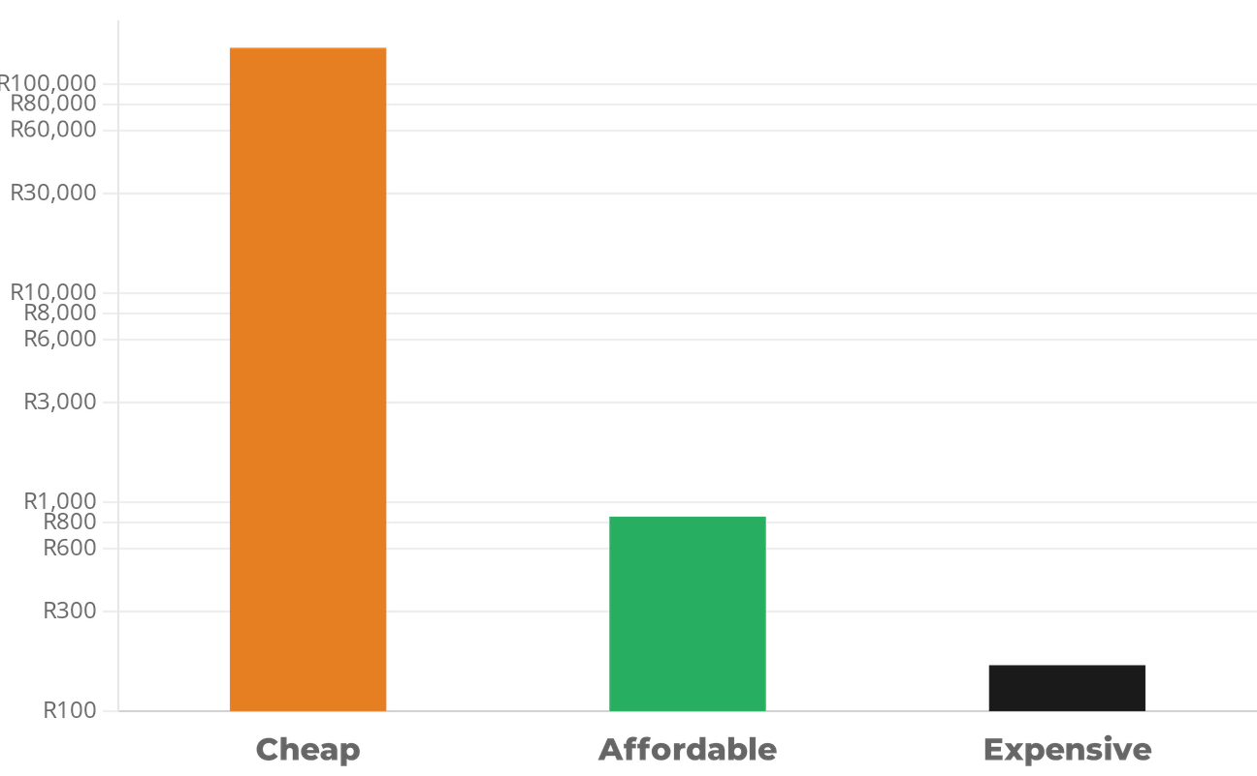
PRICE SENSITIVITY FAVORS "CHEAP" & "AFFORDABLE" TIERS
SPENDING BEHAVIOR
99.8%
VOLUME DOMINANCE
The business model thrives on high-frequency, low-cost transactions. Over R148k comes from the "Cheap" tier.
R165
PREMIUM TIER REVENUE
High-end items contribute negligible revenue, confirming customers view Bright Coffee as a daily staple, not a luxury.
STRATEGIC ACTION
Maintain competitive pricing on core beverages while using "Bakery Add-ons" to increase average transaction value.
* Revenue distribution by affordability bucket (Cheap < R10, Affordable R10-R20, Expensive > R20).

Slide 8

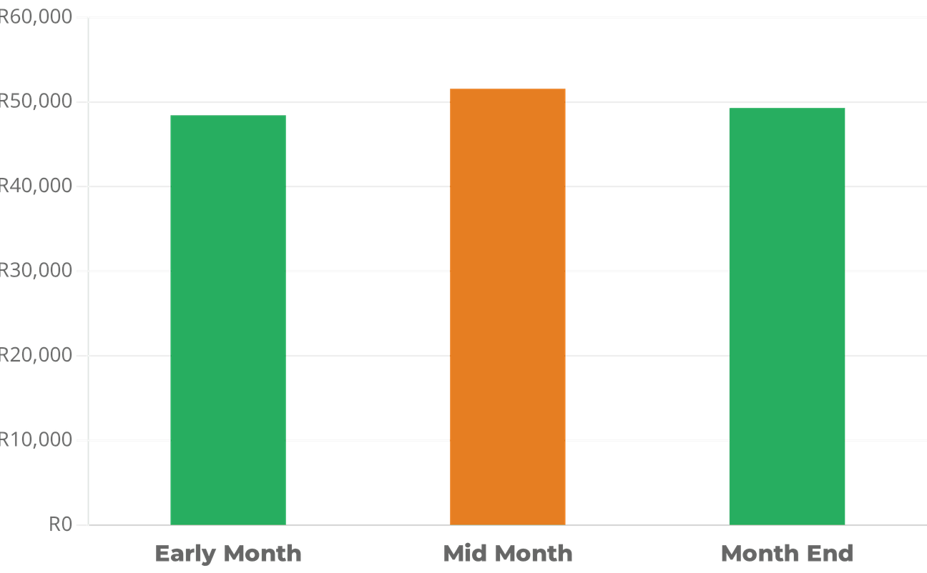
MID-MONTH SURGE SUGGESTS PAYDAY TRENDS
SPENDING BEHAVIOR
STAPLE CONSUMPTION
Revenue remains remarkably stable across all periods, indicating that coffee is a daily staple rather than a luxury for our customers.
MID-MONTH PEAK
The slight surge to R51,512 during the second week suggests a correlation with bi-weekly payday cycles.
LTO OPPORTUNITY
Limited-time offers launched during the mid-month peak could further capitalize on increased consumer liquidity.

Slide 9

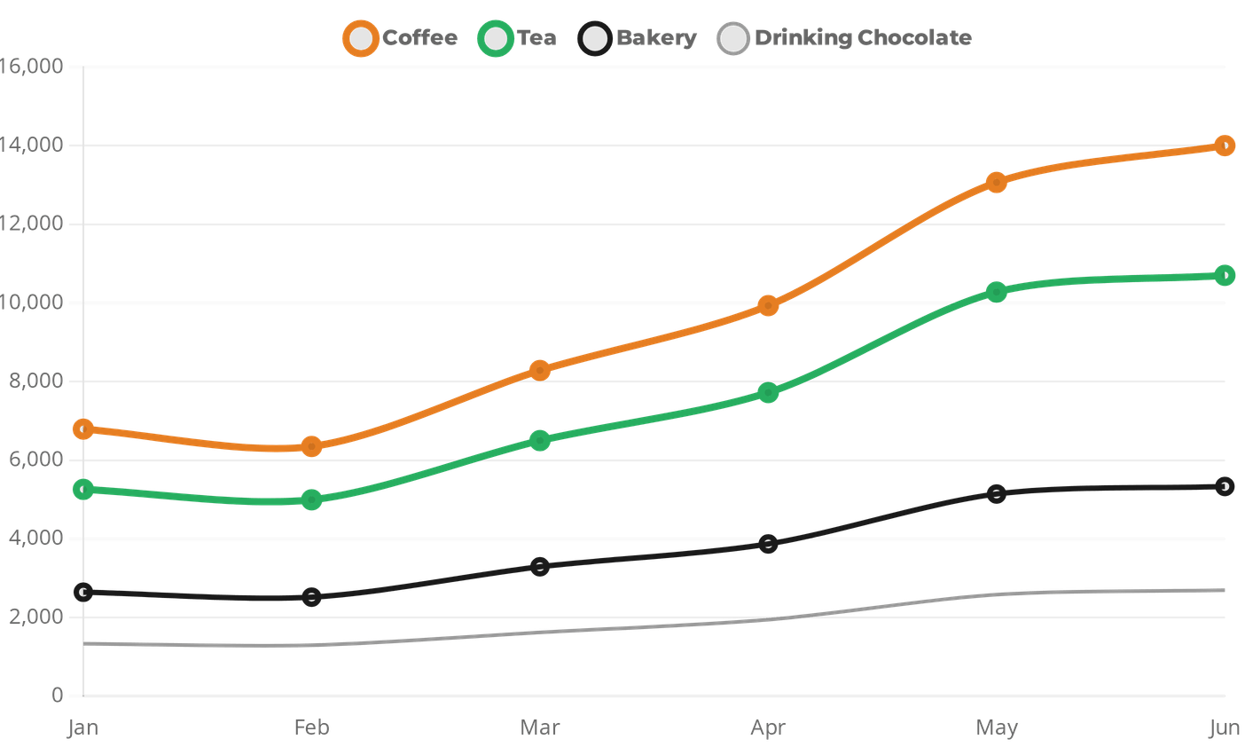
SEASONAL CATEGORY GROWTH ACROSS ALL LOCATIONS
GROWTH INSIGHTS
CONSISTENT SCALING
Every product category, from Coffee to Loose Tea, saw sustained growth from March onwards.
SPRING/SUMMER SHIFT
The sharpest increase in Tea and Drinking Chocolate occurred in May/June, aligning with seasonal demand.
RESILIENCE
Even minor categories like "Flavours" saw a doubling in revenue over the 6-month period.

Slide 10

PRODUCT & MARKETING
STRATEGIC RECOMMENDATIONS
Product Expansion
Expand the Bakery and Tea menus to leverage their high growth potential and strong attachment to coffee sales.
Targeted Marketing
OPERATIONS & PRICING
Launch weekend campaigns and evening "Happy Hour" deals to balance the weekly revenue distribution and fill slow periods.
Operational Optimization
Increase staff during the morning peak (7 AM - 11 AM) to reduce wait times and capture more "rush" revenue.
H2 2023 Goal
Focus on increasing the average transaction value through "Bakery Add-ons" and bundled morning deals.
Pricing Strategy
Stick to the high-volume, affordable pricing model that customers clearly prefer, ensuring core beverage competitiveness.

Slide 11

PROVEN SUCCESS
FUTURE OUTLOOK
HEALTHY GROWTH
The data confirms a robust, upward trajectory with revenue doubling over the first six months of 2023.
By strategically addressing the weekend and evening revenue gaps, Bright Coffee Shop is exceptionally well-positioned for a record-breaking second half of the year.
BRAND PRESENCE
Strong, consistent performance across all three prime NYC locations establishes a solid foundation for scaling.
LOYAL BASE
A dependable weekday customer base provides stable recurring revenue and high operational predictability.
"The transition from a morning staple to an all-day destination is the key to unlocking our next phase of growth."

Slide 12

THANK YOU
VHONANI MPHOSHOMALE
Data Analytics Consultant
"Turning Data into Delicious Decisions."

